Slide 1


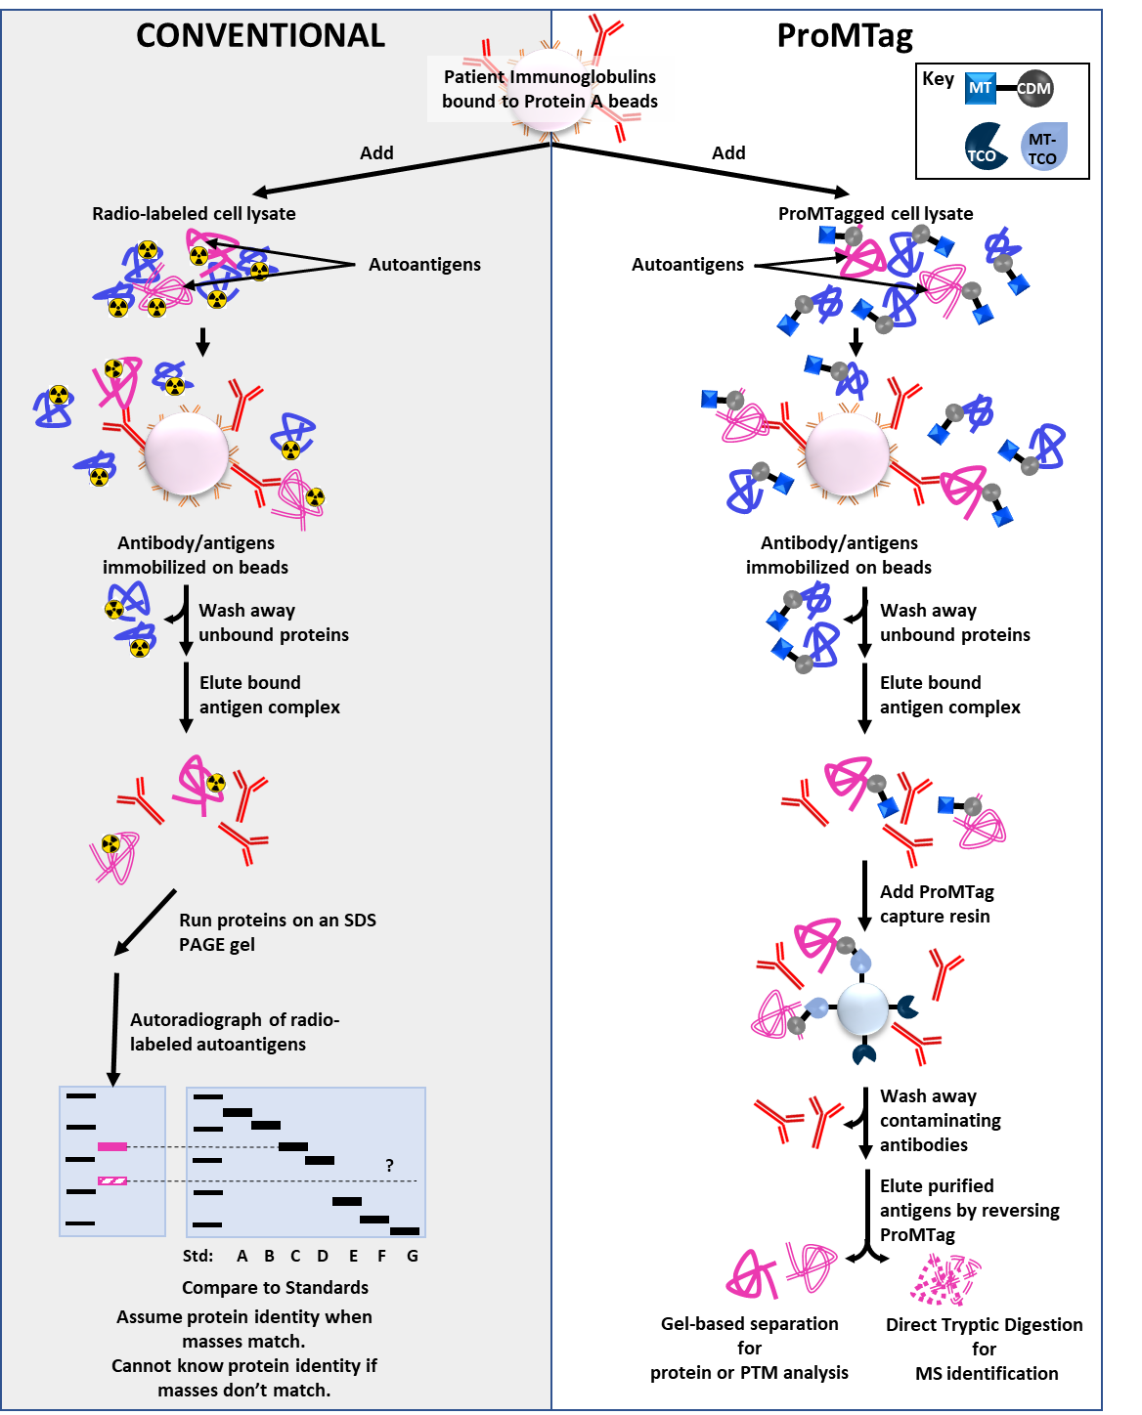
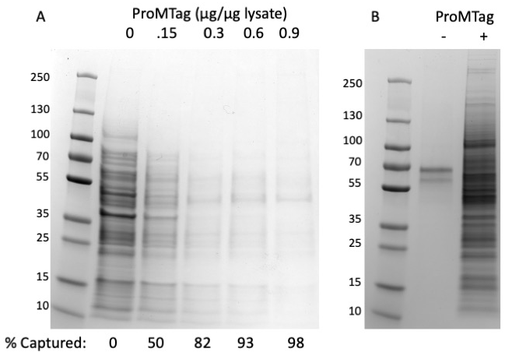

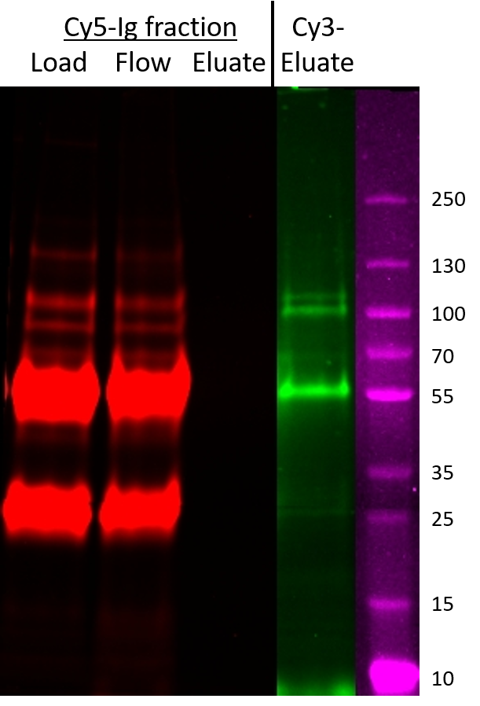
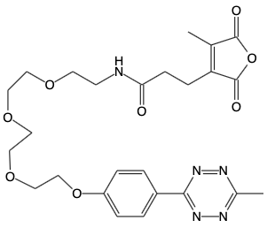

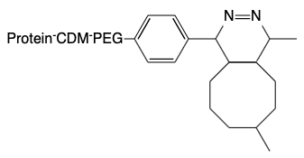
Patient-specific autoantigen sample preparation and analysis using ProMTag
Jonathan S Minden¹, Dana Ascherman², Amber Lucas¹
¹Impact Proteomics, Pittsburgh, PA; ²University of Pittsburgh, Pittsburgh, PA
Abstract
Conventional vs ProMTag method for purification of autoantigens
Control immunoprecipitation of K562 lysate with normal serum
Autoimmune diseases affect >20 million people in the US today. Currently, disease-specific autoantibodies are thought to be the best biomarkers for diagnosis. Conventional immunoprecipitation methods have been used to identify autoantigens from the most common autoimmune diseases. However, these diseases account for only 6.5 million of the 20 million patients suffering from autoimmune diseases, leaving many without diagnoses until irreversible damage occurs. The remaining 13.5 million patients have >70 autoimmune disorders without well characterized autoantibodies. The state-of-the-art diagnostic test of these remaining diseases relies on gel electrophoresis of immunoprecipitated radiolabeled proteins, which cannot be identified by MS due to safety issues and the overwhelming presence of immunoglobulins.
We have created an immunoprecipitation method that uses serum from patients with any autoimmune disorder to identify patient-specific autoantigen proteins. This method uses a reversible click chemistry tag, called ProMTag. One end of the ProMTag forms a reversible, covalent bond with protein by coupling to lysines and amino termini. The other end of the ProMTag can form an irreversible, covalent bond with a solid bead support via a click chemistry, methyltetrazine-TCO, pairing. In this study, the proteins of cell lysates that contain potential autoantigens were labeled with ProMTag. The ProMTagged-proteins were exposed to patient antibodies bound to Protein A beads, thus capturing the ProMTagged autoantigens. All proteins were released from the Protein A beads, including ProMTagged- autoantigens and untagged-antibodies. The ProMTagged-autoantigens were subsequently coupled to TCO beads, and the untagged-antibodies were washed away. The linkage between the ProMTag and autoantigens was then reversed, yielding autoantigen proteins with greatly reduced antibody contamination ready for MS analysis. MS analysis successfully identified autoantigens from patient serums with rheumatoid arthritis. This autoimmune biomarker discovery method can accelerate sample testing for known autoantigens and facilitating rapid discovery of novel autoantigens for both diagnostic and predictive biomarkers.
Mass spectrometry results of negative control identify background proteins that are in the sample after the ProMTag immunoprecipitation workflow
Immunoprecipitation of K562 lysate with commercial anti-Hsp90 antibody
Mass spectrometry analysis of antigens after ProMTag immunoprecipitation workflow with antigen HSP90-alpha show successful identification of HSP90-alpha as expected.
Immunoprecipitation of K562 lysate with four characterized patient sera
Autoantibodies from patient sera with known autoantigens were immobilized on beads and used for immunoprecipitation of a ProMTag labeled protein lysate from K562 cells. Immunoprecipitated antigens were then sent for mass spectrometry identification. In all four tests, the correct autoantigen was identified in the mass spectrometry result. There were background proteins present in the samples (highlighted in yellow), however these proteins were also in the negative control and pure HSP90 antibody sample so we can rule them out as autoantigens.
ProMTag Workflow Key Components
Gel-based validation of the ProMTag immunoprecipitation workflow
ProMTag
Protein tagging
ProMTag Capture
TCO-bead
Human serum
- +
Reversible Protein Binding Reagent
Carboxyethyl-dialkyl-maleic
Anhydride (CDM)
Trans-cyclooctene
(TCO)
Gly-tRNA synth.
Topo I
Hsp90
?
Hsp90
Expected protein IP target in pink; Common background proteins in yellow
The ProMTag immunoprecipitation method allowed for mass spectrometry of autoantigens immediately after immunoprecipitation, something that previously could not be done because of antibody contamination. Additionally, we correctly identified all known antigens in clinically relevant patient samples. However, there was residual background from common lysate and serum proteins. This background can be accounted for computationally or by optimizing the protocol’s washing steps.
Ig-Heavy Chain
?
Conclusions
TCO
Capture and release of HeLa cell lysate proteins. (A) HeLa lysate protein after tagging with an increasing amount of ProMTag and capture on TCO-beads. (B) HeLa lysate eluted from the TCO-beads +/- ProMTag labeling. We were able to show that ProMTag labeling allows for capture of HeLa cell lysate proteins and recovery of those proteins after elution.
IP and ProMTag cleanup with purified anti-Hsp90 antibody +/- addition of a human autoimmune serum (patient serum 1 from table). HeLa lysate (green) was used for IP with 1 µg of anti-Hsp90. IP was repeated with 5 µl of autoimmune serum from a patient with Gly-tRNA synthase autoantigens. We were able to pull down and cleanup Hsp90 from both pure and human serum samples. In the human sample we were also able to purify the expected autoantigen Gly-tRNA synthase. Igs can be seen in red due to Coomassie Blue staining.
MT
CDM
Ig removal after Hsp90 and Topo I IP. The Ig fraction bound to Protein A beads was labeled with Cy5-NHS (red) and the amount of Ig in the flowthrough and eluate after cleanup with ProMTag capture resin was observed. The load lane is the Ig fraction eluted from the protein A beads. Flow is the Ig fraction that did not bind to the ProMTag capture resin. Eluate shows the Ig fraction eluted from the resin (red) with the HeLa lysate proteins that were eluted after IP and ProMTag cleanup (green).
Acknowledgements
Irreversible Bead Binding Reagent
Methyltetrazine (MT)
MT-TCO reaction
product
This work was supported by NSF SBIR Phase II Award 2036199. This work was also supported in part by NIH P30 CA124435 utilizing the Stanford Cancer Institute Proteomics/Mass Spectrometry Shared Resource at the Vincent Coates Foundation Mass Spectrometry Laboratory, Stanford University Mass Spectrometry (RRID:SCR_017801). We thank Ryan Leib and the Stanford University Mass Spectrometry Facility for their help with mass spectrometry analysis, data analysis, and statistical analysis.
MT-
TCO

